Slide 1


Data-Driven Recruitment System
Optimizing Biased Talent Acquisition Through Data-Driven HR Analytics

Slide 2
Exploratory Data Analysis

Slide 3




Descriptive Statistics
Features | Description
Age | Candidate’s age
ExperienceYears | Candidate’s total years of work experience
PreviousCompanies | Candidate’s total previous company
DistanceFromCompany | Candidate’s home distance from company
InterviewScore | Candidate’s interview score result
SkillScore | Candidate’s technical score result
PersonalityScore | Candidate’s personality score result
Gender | 0 = Male, 1 = Female
EducationLevel | 1 = High Shcool, 2 = Diploma/Bachelor, 3 = Magister, 4 = PhD
RecruitmentStrategy | 1 = Internal, 2 = External, 3 = Referral
HiringDecision | Target: 0 = Not Hired, 1 = Hired
ExperienceLevel | Junior (0-2 YoE), Medior (2-5 YoE), Senior (5+ YoE)
Data shape: 1.500 rows and 11 feature columns
Feature type: 7 numerical, 3 categorical, 1 target
Missing values: 0
Duplicate values: 0
Outliers: 0
Numerical Features
Categorical Features
Age
ExperienceYears
PreviousCompanies
DistanceFromCompany
InterviewScore
SkillScore
PersonalityScore
Gender
EducationLevel
RecruitmentStrategy
Target: Hiring Decision
Feature Engineering
Hired
ExperienceLevel
31%
Transforms continuous numerical data in ExperienceYears feature into discrete categories (binning).
Not Hired
69%

Slide 4
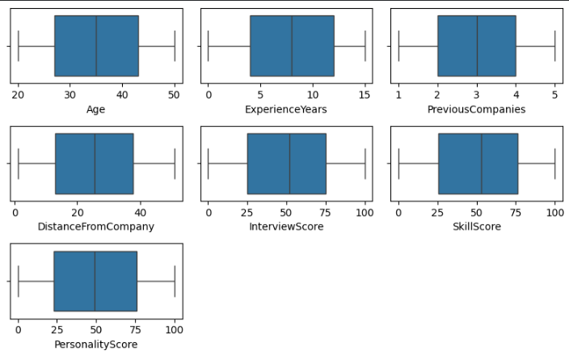
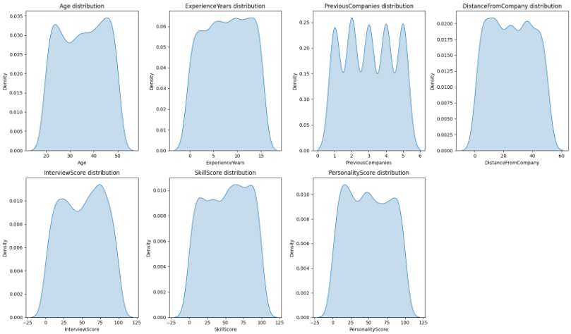
Univariate Analysis
No data points were found outside the whiskers for each features. This indicates the dataset is free from outliers, thus model will not be affected by significantly deviant values.
The distribution plot looks approximately symmetric, meaning no significant skew is present.
Due to the neat data distribution and lack of outliers, this dataset is ideal and can move into the modeling stage without the need for complex outlier handling.

Slide 5
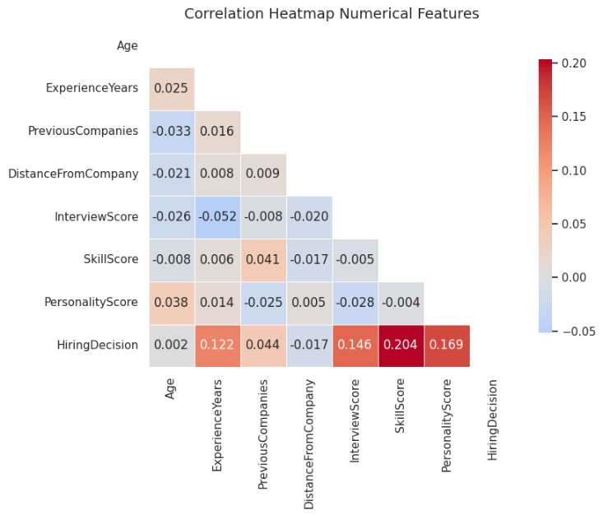
Multivariate Analysis
Most of the numerical features have a low to moderate correlation with each other, with correlation values ranging from -0.052 hingga 0.044.
No features show a very high correlation (above 0.8), which indicates that there is no significant multicollinearity among them.
Features such as ExperienceYears, InterviewScore, SkillScore, PersonalityScore, show a significant positive correlation with the target label (HiringDecision)."

Slide 6
Chi-Square & ANOVA Test Result
ANOVA
Chi-Square
Feature | F-stat | p-value
Age | 0.005 | 0.9429
ExperienceYears | 22.819 | 0.0000
PreviousCompanies | 2.909 | 0.0883
DistanceFromCompany | 0.422 | 0.5158
InterviewScore | 32.656 | 0.0000
SkillScore | 64.827 | 0.0000
PersonalityScore | 44.137 | 0.0000
Age | 0.005 | 0.9429
Chi2 | p-value | dof | Feature
0.001 | 0.9751 | 1 | Gender
103.675 | 0.0000 | 3 | EducationLevel
489.681 | 0.0000 | 2 | RecruitmentStrategy
39.198 | 0.0000 | 2 | ExperienceLevel

Slide 7
Insight Extraction

Slide 8
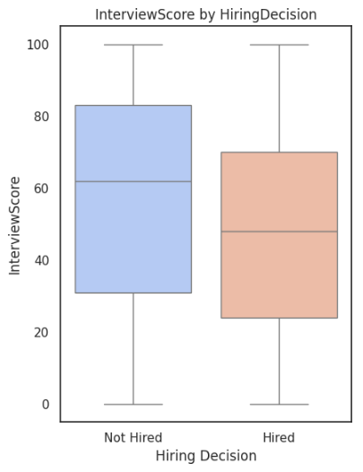
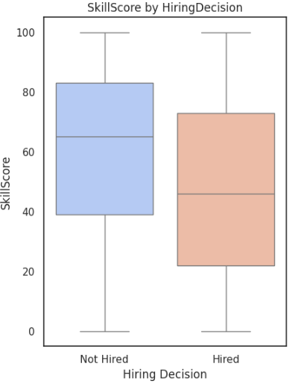
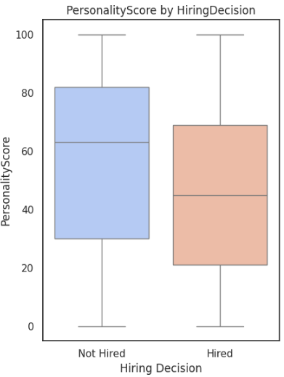
Score-based Features Likely Insignificant to Hiring Decision
InterviewScore: Unsuccessful candidates had a median interview score above 60. Accepted candidates had a median below 50. This indicates that in this dataset, interview scores were not a primary determinant of recruitment success, or that other factors were more dominant.
SkillScore: The range of skill scores for successful candidates was wider, with a median of around 45. Meanwhile, unsuccessful candidates had a higher concentration of scores in the upper range (median >60).
PersonalityScore: Shows a similar pattern to the other variables, with the lower bound (Q1) for successful candidates being (~20) and the lower bound (Q1) for unsuccessful candidates being (~30).

Slide 9
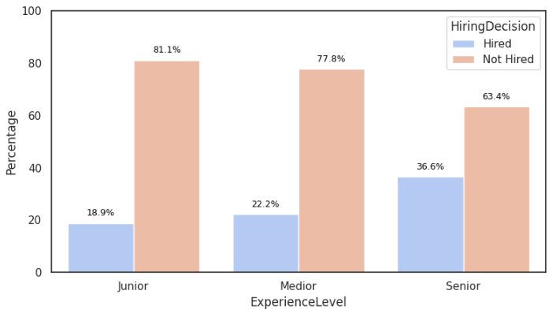
Senior-level Candidates are More Likely to be Hired
ExperienceLevel is significant to HiringDecision
From the data shown, we can visualize a direct positive correlation between experience level and hiring success. Senior-level candidates are significantly more likely to be hired compared to Junior and Medior levels, suggesting a strong industry preference for established expertise.
Senior candidates have the highest hiring rate at 36.6%, which is nearly double that of Junior candidates (18.9%) whereas Junior applicants face the toughest competition, with a non-hiring rate of 81.1%.
Incremental Growth: There is a steady upward trend in "Hired" percentages as candidates move from Junior (18.9%) to Medior (22.2%) and finally Senior (36.6%).

Slide 10
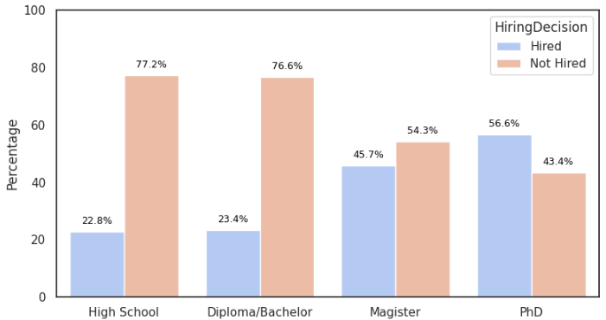
Higher Education Level = Higher Probability to be Hired
EducationLevel is significant to HiringDecision
Candidates with a high school (22.8%) and a diploma/bachelor (23.4%) have almost equally low acceptance rates. The vast majority (over 76%) of this group failed the selection process.
Magister’s degree graduates shows a significant increase in their chances of being accepted, reaching (45.7%). This suggests that a magister’s degree is an important "threshold" for companies in selecting candidates.
PhD degree graduates have the highest hiring rate at (56.6%). This was the only group where more candidates were accepted than rejected (above 50% ratio).

Slide 11
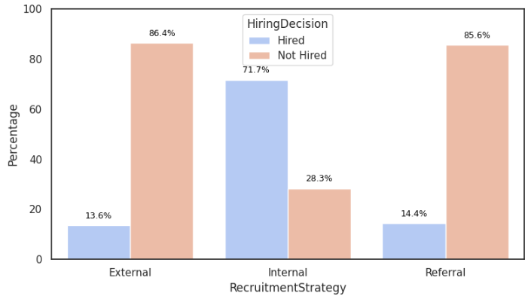
Most Hired Candidates are Internal Applicants
RecruitmentStrategy is significant to HiringDecision
The internal recruitment strategy has a success rate far exceeding other channels. 71.7% of candidates through the internal channel are hired. This is the only category where the number of accepted candidates significantly outnumbers those rejected.
In contrast to internal applicants, candidates who come from outside sources or through referrals have a very low chance of being accepted:
External: Only 13.6% are accepted.
Referral: Only 14.4% are accepted.
Both of the non-internal applicants have high rejection rates, exceeding 85%.

Slide 12

Feature Selection
The features identified as strongly correlated with the target should be prioritized for modeling, as they are expected to yield the best evaluation results.
ExperienceYears
ExperienceYears shows a moderate correlation with hiring outcomes and contains many unique values, making it suitable for binning.
SkillScore
Skill Score shows a moderate correlation with hiring outcomes, where candidates with higher scores are more likely to be accepted.
DistanceFromCompany
DistanceFromCompany did not show a statistically significant effect on recruitment decisions.
EducationLevel
Candidate education level shows a fairly strong correlation with hiring outcomes, with higher educational levels associated with greater acceptance.
InterviewScore
Interview Score shows a moderate correlation with hiring outcomes, where candidates with higher scores are more likely to be accepted.
ExperienceLevel
There is a significant relationship where higher levels of experience tend to have a greater chance of acceptance.
RecruitmentStrategy
Recruitment strategy shows a strong correlation with hiring outcomes, with aggressive strategies leading to higher acceptance rates.
PersonalityScore
Personality Score shows a moderate correlation with hiring outcomes, with higher scores linked to a greater likelihood of acceptance.
Age
Age had no significant correlation with recruitment outcomes, indicating that the model provides equal opportunities regardless of candidate age.
PreviousCompanies
This feature shows an insignificant effect. This means that the number of companies a candidate has previously worked for is not a major determinant of hiring decisions in this model.

Slide 13
Data Pre-processing
Feature
Encoding
Split Data (70:30)
Data Balancing
Feature
Scaling
Model Training
Ordinal Encoding
For categorical features with logical order. Example: EducationLevel where each category is converted to a number representing that order (1, 2, 3, 4).
SMOTE
This technique handles imbalanced data by creating new, synthetic data for the minority class. SMOTE helps the model learn to better recognize the characteristics of the minority class, thereby improving detection performance.
StandarScaler
Numerical features will be processed using StandardScaler to ensure they share a similar range, allowing the model to learn more effectively.
One Hot Encoding
For categorical features with more than two unique values. For example: ExperienceYear (Junior, Medior, Senior)

